Slide 1

Thomas Kyte
http://asktom.oracle.com/

Slide 2
Flashback
Flashback Query
  9iR1 – primitive
  Had to open flashback cursors before doing any DML
  It worked, but was not “easy”
Fb0.sql

Slide 3
Flashback
Flashback Query
  9iR2 – sophisticated
  No need to open cursors before doing modifications
  Can flashback in SQL, no packages needed
  Can flashback in modifications
  It worked and was much easier
    Could join the table with itself as of N minutes ago
    Put update a set of rows, put them back as they were N minutes ago
    In SQL
Fb1.sql

Slide 4
Flashback
In 10g
  Flashback Query
  Flashback Table
  Flashback Row History
  Flashback Drop
  Flashback Database
In 11g
  Flashback Data Archive

Slide 5
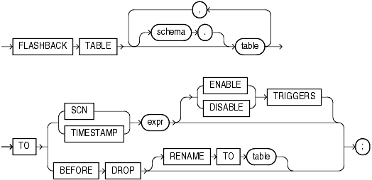
Flashback – Flashback Table

Slide 6
Flashback – Flashback Table
SQL Undo based – automates the compensating SQL that can get quite tricky to write
  Fb2.sql
In a nutshell
  Deletes all rows inserted/modified since that SCN/Time
  Inserts all rows modified/deleted since that SCN/Time
  Rowids therefore will change (must enable row movement on the table)
  Let’s see what is under the covers here
    Fb3.sql
  What about RI?
    Fb4.sql

Slide 7
Flashback – Flashback Table
Rowids Change
All Tables locked
A single Transaction (it is DDL, either all works or none works)
  Flashback 50 tables or 1 table – one big “refresh”
RI Constraints verified in a deferred fashion (apparently)
Statistics do not “flashback”
Indexes
  Are neither “dropped” nor “created”
  If they did not exist at the flashback PIT, they will now
  If they were dropped after the flashback PIT, they will still be dropped
  Fb5.sql

Slide 8
Flashback – Flashback Table
No
  Clusters
  MV’s
  AQ
  Dictionary tables (duh)
  Remote Tables
  Object Types
  Nested Tables
  Partitions/Sub-partitions (entire table)
Fb_part.sql

Slide 9
Flashback – Flashback Table
Various DDL may prevent flashbacks, such as
  Moving (no undo generated)
  Truncating (no undo generated)
  Constraints (fb6.sql – since only modified rows would be validated)
  Add/Drop column
  Partition operations (except adding a range partition)
Triggers are disabled by default
  And I cannot imagine the use case where they would be enabled (well, maybe auditing)

Slide 10
Flashback – Flashback Row History
Instead of “show me the data as of”, you can say “show me all versions of the data between”
Select ename, sal
from emp versions between timestamp a and b
where ename = ‘SCOTT’
ENAME SAL
---------- ----------
SCOTT 3000
SCOTT 3300
SCOTT 3630
…

Slide 11
Flashback – Flashback Row History
See related information about each row
  SCN range the row was “valid for”
  Time range (approx) the row was valid for
  The transaction id (XID) that modified the row
  The operation (I/U/D) that was performed on the row
select ename, sal,
versions_operation,
versions_starttime,
versions_endtime,
versions_startscn,
versions_endscn,
versions_xid
from emp versions between timestamp &A and &B
where empno = 7788
order by versions_startscn nulls first
Fb7.sql

Slide 12
Flashback – Flashback Row History
Related psuedo column ORA_ROWSCN
  Approximate by default
  Rowdependencies makes it exact
Scn_to_timestamp
  Approximate mapping to time
  3 second interval
sys@ORA10G> desc smon_scn_time
Name Null? Type
----------------- -------- ------------
THREAD NUMBER
TIME_MP NUMBER
TIME_DP DATE
SCN_WRP NUMBER
SCN_BAS NUMBER
NUM_MAPPINGS NUMBER
TIM_SCN_MAP RAW(1200)
SCN NUMBER
ORIG_THREAD NUMBER
sys@ORA9IR2> desc smon_scn_time
Name Null? Type
----------------- -------- ------------
THREAD NUMBER
TIME_MP NUMBER
TIME_DP DATE
SCN_WRP NUMBER
SCN_BAS NUMBER
Fb9.sql

Slide 13
Flashback – Flashback Table
Undrop a table!

Slide 14
Flashback – Flashback Table
Uses a recycle bin metaphor
  Table/indexes/triggers/constraints are renamed
  Extents are not deallocated immediately
  Whether you can undrop something depends entirely on how “full” your tablespace was!
  This is useful for “whoops” recovery right after the fact
  You may be able to undrop a table months after the fact
  You may not be able to undrop a table seconds after the fact!
Fb10.sql

Slide 15
Flashback – Flashback Table
Multiple table T’s may exist in the recycle bin
  HTML/DB demo story
You should rename indexes et.al. after the fact
RI (foreign keys from child tables) are not “undropped”
  You had to specify “cascade constraints”
  The fkeys are not really part of “this table” anyway
Fb11.sql

Slide 16
Flashback – Flashback Table
Only works for non-system, LMT’s
You can query dropped objects (but no modifications/DDL)
You can even flashback query them (but that’s getting a a little carried away…
VPD tables not recycled
MV logs do not come back
MV’s are not recycled

Slide 17
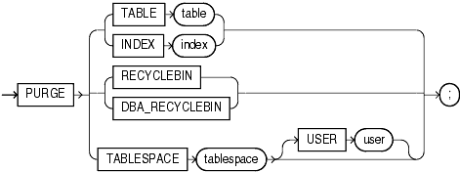
Flashback – Flashback Table
You can PURGE objects, once purged – they are gone
  A single table or index
  The current users recyclebin set of objects
  The entire systems set of objects
  All objects in tablespace ‘X’
  All objects for the given user

Slide 18
Flashback – Flashback Table
Drop table also has a PURGE option
  Don’t get in the habit of using it.
  Keep it a two step “drop”/”purge” operation if you want to reclaim space
  Why? Makes it almost impossible to “accidentally” drop a table, you really really want to get rid of that thing since it takes two command.
Cannot “untruncate” a table

Slide 19



Flashback Database
A new strategy for point in time recovery
Flashback Log captures old versions of changed blocks
  Think of it as a continuous backup
  Replay log to restore DB to time
  Restores just changed blocks
It’s fast - recover in minutes, not hours
It’s easy - single command restore
  SQL> Flashback Database to ‘2:05 PM’
Disk Write
New Block
Version
Old Block
Version
Data
Files
Flashback Log
“Rewind” button for the Database
Holds old block contents
Fbdb.sql

Slide 20
Flashback Database
Cannot recover from media failure, that’s still the job of conventional backup and recovery
You can mix restore and flashback (dropped datafiles)
Flashback retention is a target, not a directive
Must be in archive log mode (but you already must be anyway)
Must use flash recovery area (anyone remember version 5)

Slide 21
Flashback Database
Yes, it will increase write IO (flashback recovery area)
But – so does
  Archive log mode
  The way we do undo and redo
  Everything pretty much – we can design (eg: plan) for it

Slide 22
Flashback Data
Archive

Slide 23
Historical Data Storage
A new database object, flashback data archive, is a logical container for storing historical information
Consists of one or more tablespaces
  ‘QUOTA’ determines max amount of space a flashback data archive can use in each tablespace (default is Unlimited)
Specify duration for retaining historical changes using ‘RETENTION’ parameter
Tracks history for one or more tables
  Tables should share the archiving characterstics
Automatically purges aged-out historical data based on retention policy
Create as many flashback data archives as needed
  Group related tables by desired retention period
  - HIPAA requires all health transactions be maintained for 6 years
Flashback
Data
Archive
Tablespaces
Tracked tables in all tablespaces inherit RETENTION and Purge policies
Notes:
In a tablespace, a flashback data archive can co-exist with other objects. It is recommended to create dedicated tablespaces for flashback data archives and leave the quota at the default value of ‘unlimited’.

Slide 24
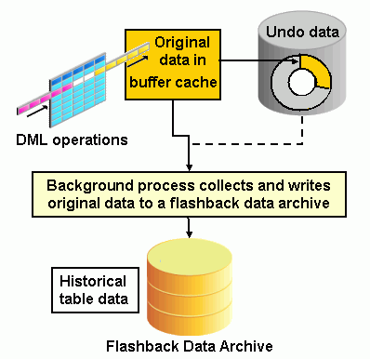
How Does Flashback Data Archive Work?
Primary source for history is the undo data
History is stored in automatically created history tables inside the archive
Transactions and its undo records on tracked tables marked for archival
  Undo records not recycled until history is archived
History is captured asynchronously by new background process (fbda)
  Default capture interval is 5 minutes
  Capture interval is self-tuned based on system activities
  Process tries to maximize undo data reads from buffer cache for better performance
  INSERTs do not generate history records

Slide 25
Flashback Data Archive And DDLs
Possible to add columns to tracked tables
Automatically disallows any other DDL that invalidates history
  Dropping and truncating a tables
  Dropping or modifying a column
Flashback Data Archive guarantees historical data capture and maintenance
  Any operations that invalidates history or prevents historical capture will be disallowed
Notes:
On a table with flashback data archiving enabled, if records are inserted and never updated, there will be no history generated!
Disabling archiving will drop the internal history tables. Re-enabling archiving will create a new set of history tables. It will not pick up from where it left off.
Comprehensive DDL support on FDA-enabled tables in a future release (TBD)

Slide 26

Creating Flashback Data Archive & Enable History Tracking
1
2
3
  Create tablespace (ASSM is required)
  Create a flashback data archive
    Set the retention period
    CREATE FLASHBACK ARCHIVE fda1
    TABLESPACE tbs1
    RETENTION 5 YEAR;
  Enable archiving on desired tables
  ALTER TABLE EMPLOYEES FLASHBACK ARCHIVE fda1;
Requires new system privilege FLASHBACK ARCHIVE ADMINISTER
Flashback
Data
Archive
Flashback
Data
Archive
Requires new object privilege FLASHBACK ARCHIVE
Notes:
Add a desc sys_fba_hist_xxxxx to demo steps..

Slide 27
Managing Flashback Data Archive
Static data dictionary views
  *_FLASHBACK_ARCHIVE - Displays information about Flashback Data Archives.
  *_FLASHBACK_ARCHIVE_TS - Displays tablespaces of Flashback Data Archives.
  *_FLASHBACK_ARCHIVE_TABLES - Displays information about tables that are enabled for flashback archiving.
Alerts generated when flashback data archive is 90% full
Automatically purges historical data after expiration of specified retention period
Supports ad-hoc purge by administrators (privileged operation)
  ALTER FLASHBACK ARCHIVE fla1 PURGE BEFORE TIMESTAMP (SYSTIMESTAMP - INTERVAL '1' DAY);

Slide 28
Managing Flashback Data Archive
SYS_FBA_HIST_* - Internal History Table
  Replica of tracked table with additional timestamp columns
  Partitioned for faster performance
  Tune performance using indexes
  Compression reduces disk space required
  No modifications allowed to internal partitions
Applications don’t need to access internal tables directly
  Use ‘AS OF’ to seamlessly query history
Notes:
-> no copying primary key indexes in R1…DBA’s can add indexes for better performance

Slide 29
Questions

